Slide 1
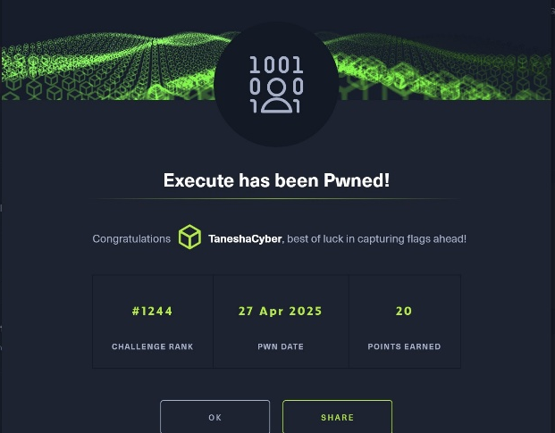
Project Execute (HTB)
CSCE 5552 Spring 2025
Harry Fu, Hollie King
Tanesha Hollingshed, Tayiba Raheem

Slide 2



HTB Challenge: Execute
HTB Execute screen shot
Very little information available
Download 3 files
Notes:
Challenge Catetory: PWN
pwn challenges are about binary-exploitation
Given a vulnerable binary to analyze locally and try to spawn a shell
The main goal is to be able to spawn a shell remotely

Slide 3
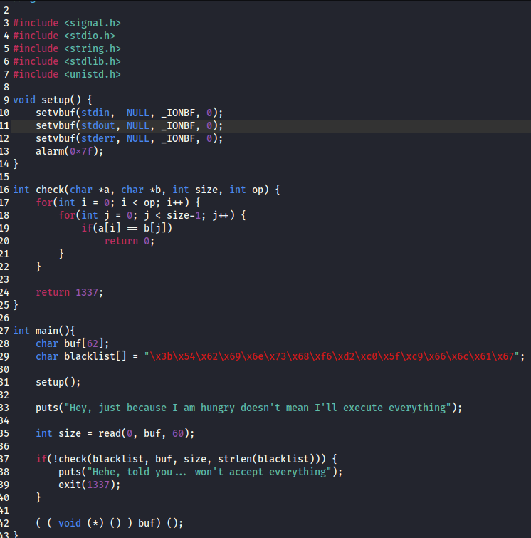
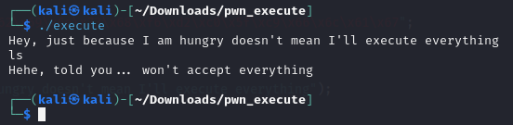
Source File and Behavior
C Source code for exe
blacklist
read, buf[] - size 60
check()
if character in blacklist
exit
Behavior
Normal commands filtered with automatic exit

Slide 4
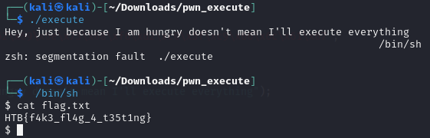
Goal and Long String Test
The Goal is to submit the flag to HTB
Local flag.txt for testing
Remote flag.txt is the target
Local test – Long String
Notice the read buf size is 60.
Adding “/bin/sh” after 60 chars? Can we access the shell?
Yes

Slide 5
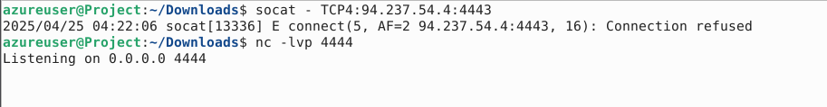
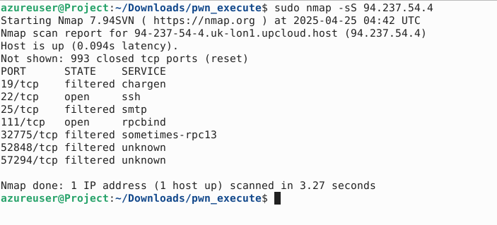
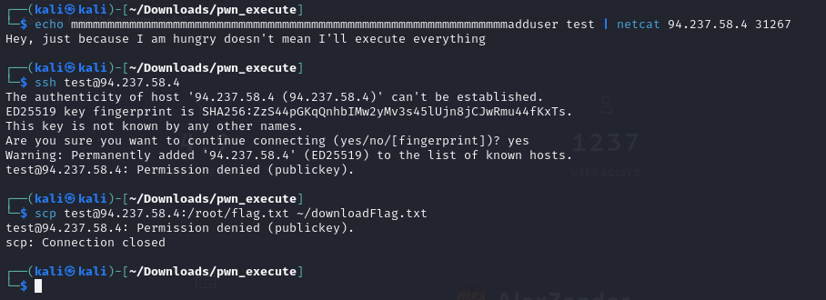
Apply Long String to Remote

Slide 6
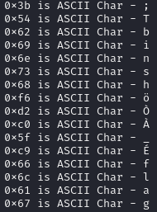
Different Route and Idea
Revisit the blacklist
"\x3b\x54\x62\x69\x6e\x73\x68\xf6\xd2\xc0\x5f\xc9\x66\x6c\x61\x67"
The blacklist is mainly targeting “/bin/sh” and “flag”
0x3b for execve()
Solution idea - shell ASM code
Encode “/bin/sh” to get around filter
Decode with key to retrieve “/bin/sh”
Trigger system call - execve()

Slide 7
ASM ShellCode
shellcode = '''
mov rax, 0x2020202020202020
push rax
mov rax, 0x2020202020202020 ^ 0x68732f6e69622f
xor [rsp], rax
mov rdi, rsp
push 0x0
pop rsi
push 0x0
pop rdx
push 0x3a
pop rax
add al, 0x1
syscall
'''
push key to stack
encrpted /bin/sh
decrpt /bin/sh by XOR key and encrpted string
1st argument to sys call points to decrpted /bin/sh
2nd argument to sys call is NULL
3rd argument to sys call is NULL
sc = asm(shellcode) sh.sendline(sc) sh.interactive()
rax to 03b, which sets execve() call

Slide 8
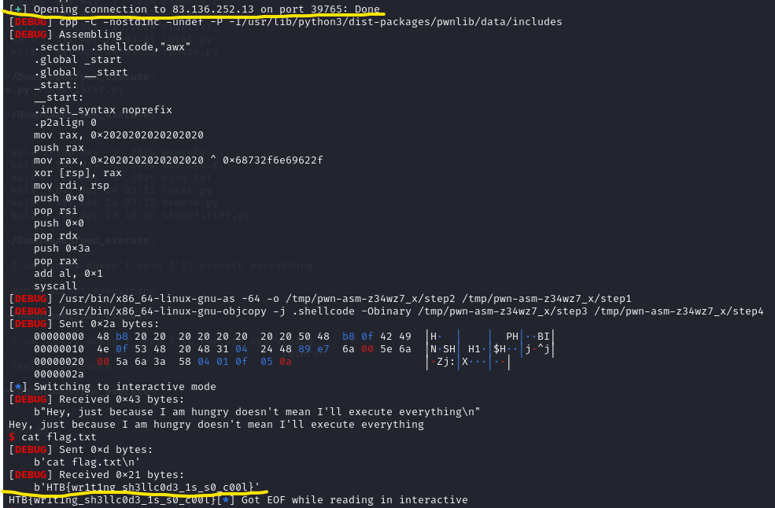
Screenshot of the Results
Success
Notes:
At the top, build the remote connection to the HTB server with PWN tools
At the bottom, it shows that we gain the access to the /bin/sh shell and able to run "cat flag.txt" to retrieve the flag, which we submitted to HTB to resolve the challenge.
HTB{wr1t1ng_sh3llc0d3_1s_s0_c00l}
https://www.hackthebox.com/achievement/challenge/2242730/640sl

Slide 9
Summary of Steps to Hack The Box: Execute (Buffer Overflow Challenge)
This was a buffer overflow vulnerability. The target program expects a fixed amount of input, but if too much characters, it overflows the memory, allowing you to control the execution flow. In this challenge, our team discovered that after 60 characters, the overflow occurs, enabling command injection.
Our Team's Strategy
We put 60 characters → Filled the program's input buffer exactly (using harmless characters like 'm’).
Certain characters (like /, ., f, l, a, g) are blacklisted and will cause the program to exit if detected, so avoid them at this stage.
Then we executed a command immediately after properly filling the buffer and injected our own crafted code to control program behavior.

Slide 10
Cont. Summary of Steps to Hack The Box: Execute (Buffer Overflow Challenge)
Analyzing the C Source Code
The buf[] is limited to 60 bytes.
Specific characters are checked; if any are detected, the program exits.
Normal command input is filtered.
A long string input can overflow the buffer and control execution.
The blacklist blocks direct use of strings like /bin/sh and keywords like flag.
We built shellcode manually (Assembly) to spawn a shell without using blacklisted characters.
Encoded the critical string (/bin/sh) to avoid blacklist detection.
Decoded it in memory at runtime.
Triggered a system call (execve) to execute /bin/sh.
Created a remote connection to the HTB server using Pwntools (Python library).
Injected custom Assembly (ASM) shellcode: Encoded /bin/sh safely; Decoded it dynamically during execution; Calls execve() to spawn a shell.
Result: Gained shell access and successfully run cat flag.txt to retrieve the flag. Flag captured: HTB{wr1t1ng_sh3llc0d3_1s_s0_c00l}

